Slide 1
Creating an Accessible Microscope Imaging Platform
ImJoy | UC2

Slide 2
Motivation
Resolving means more than a 1/0 test result
or
Seeing is believing

Slide 3


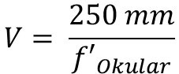

Research
Education
Reproducibility in optical setups
Microscopy as a service (cloud)
Point of care
Microscopy network
create data for machine learning
Research microscope
Emphasize interdisciplinarity
lower contact barriers
get people motivated for science
educate “microcopists” with hands-on-experiments
=> touching optical surfaces highly welcome!
Ocular
Illumination
Objective
Tubelens
Intermediate
Image
DMD
Mirror
Object

Slide 4

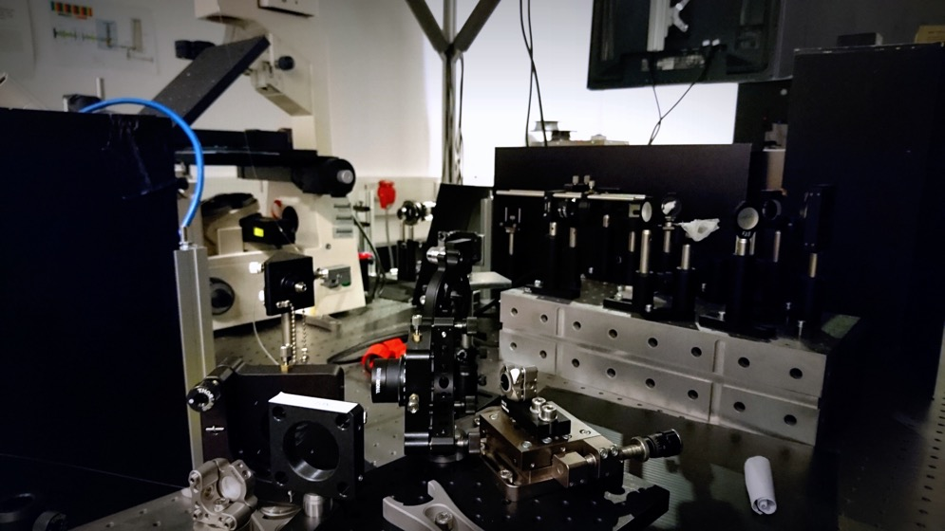
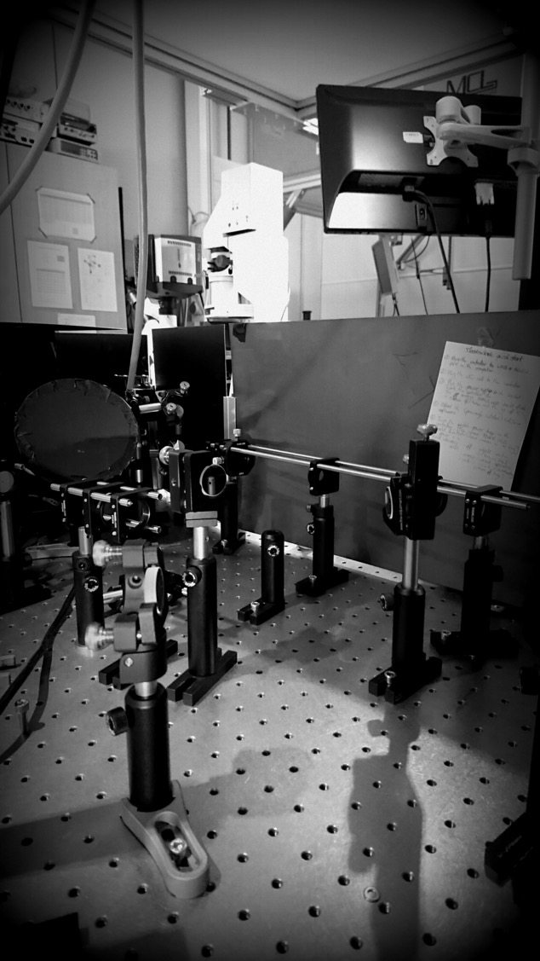

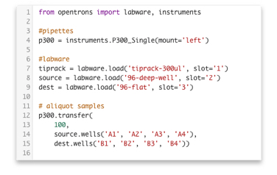


Research: Reproducibility
Optics
Biology
Automize
Standardize
Illustration: Paul Blow
Light Source
Lens
Object
Objective
Lens
Camera

Slide 5

Education: Everyday optics
1. Develop Electronic Circuit
2. Design PCB
3. Manufacture Electronics
4. Programm + Debug
2-3 Weeks
5. Pray that it works!

Slide 6
2-3 Minutes

Slide 7










The best of open-source: Bridging Open Hard- and Software
Software
Software

Slide 8












Sharing is Caring = > Equality in Science & Research
Soft/Hardware Development
Idea
Develop
Testing
Publish
Global Class by Manu Prakash
Install
Publish
Experiment
Download
Print
Open-Access
Users
Developers
General Public
Distribute => Microscopy CLoud

Slide 9
What we want to do?

Slide 10
The Starting Point Examples: Transmission Widefield Microscope
L
XYZ
MO
CAM
M

Slide 11
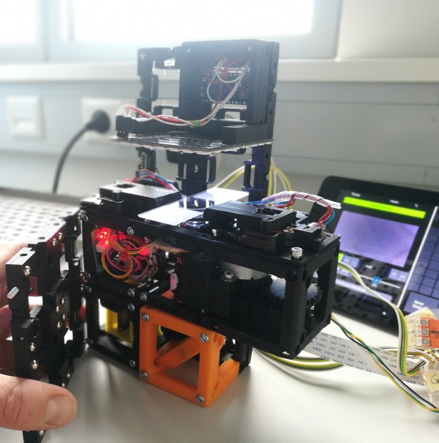
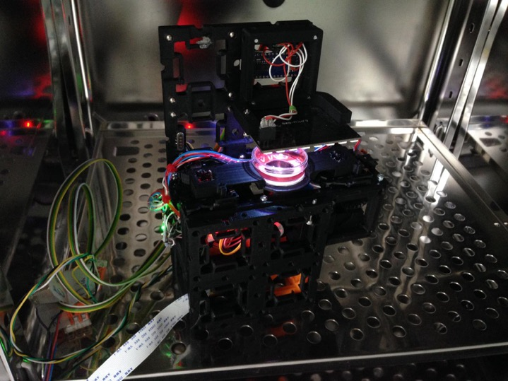
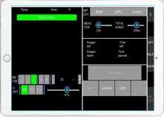
Application In-Incubator Microscope
René Richter
Raw Plan
(z-drive)
CAD-Design
UC2 In-Incubator Microscope
Version 2 – real setup
Live in Incubator
* Paper in Preparation
Control from Office
Observe Cells remotely
(soon)

Slide 12
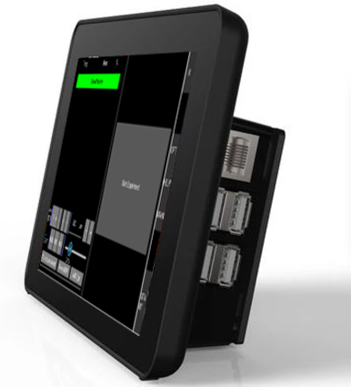
Modular Software Hardware Control: MQTT/WiFi
In-Vivo,
T-cells, 18h
LED-Matrix
Remote Control App
(Cellphone)
Z-Stage
Incubator Microscope
Remote Control App
(Raspi)
MQTT Broker, WiFi Router, Camera controler

Slide 13

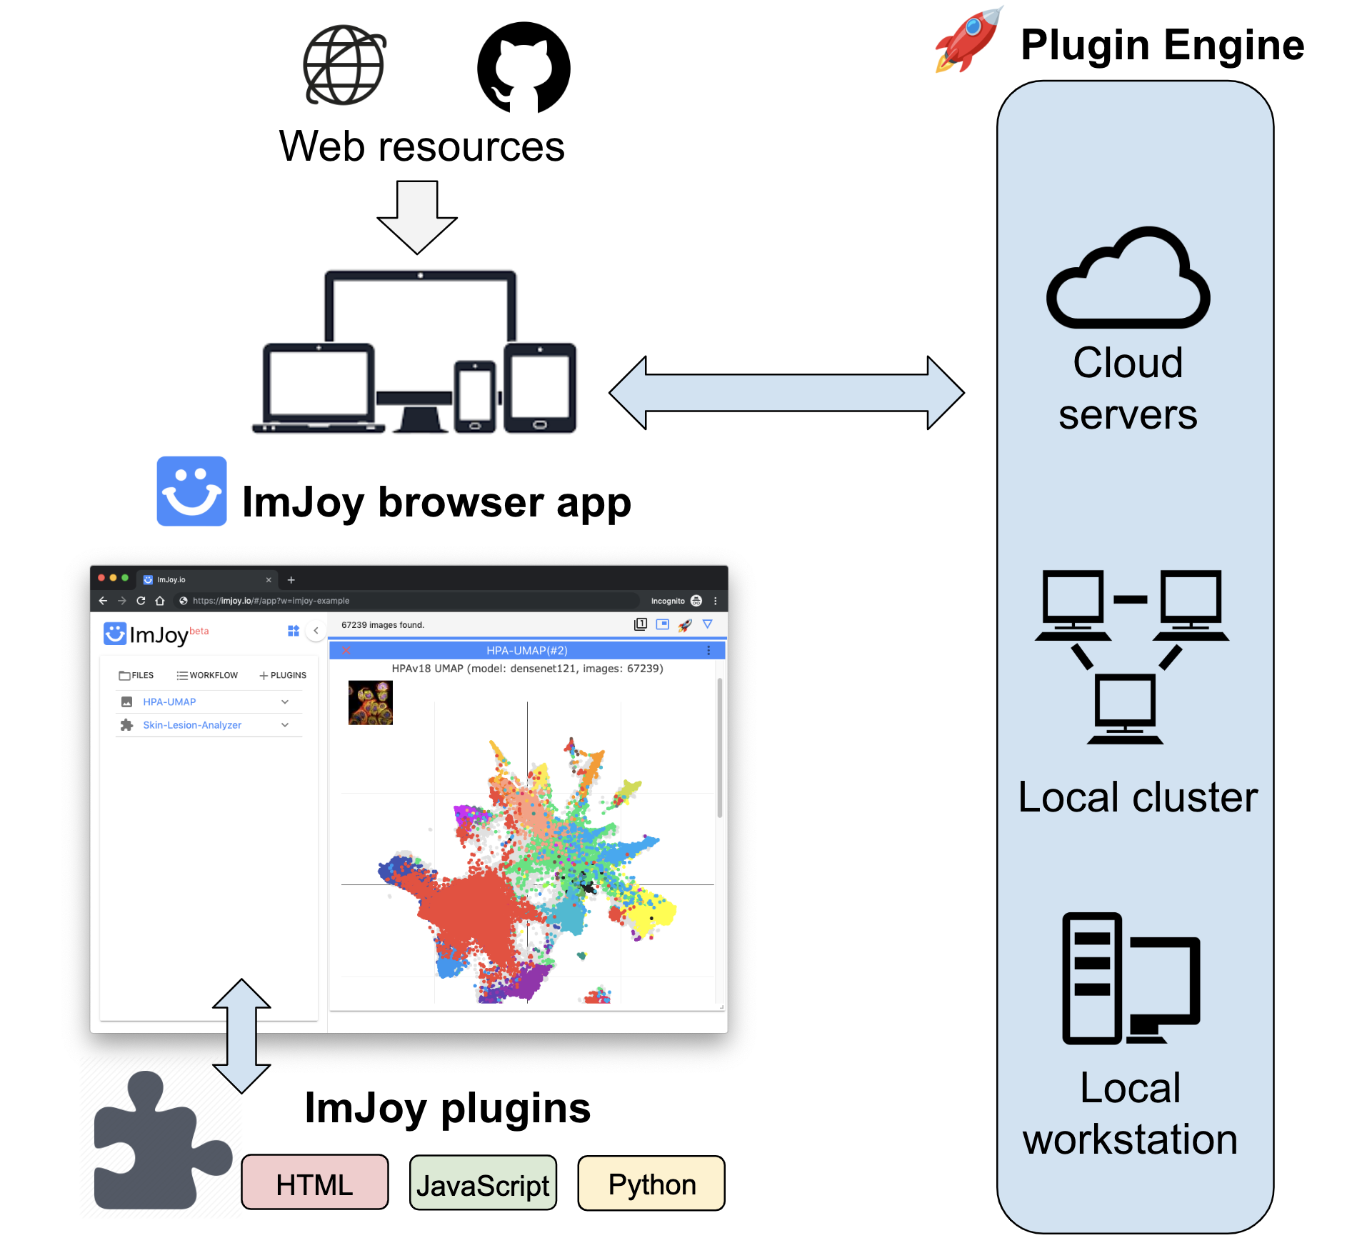

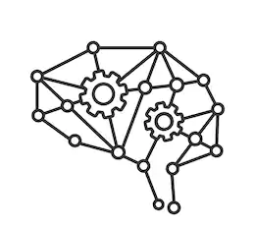
Wei Ouyang
Users
Deep Learning

Slide 14
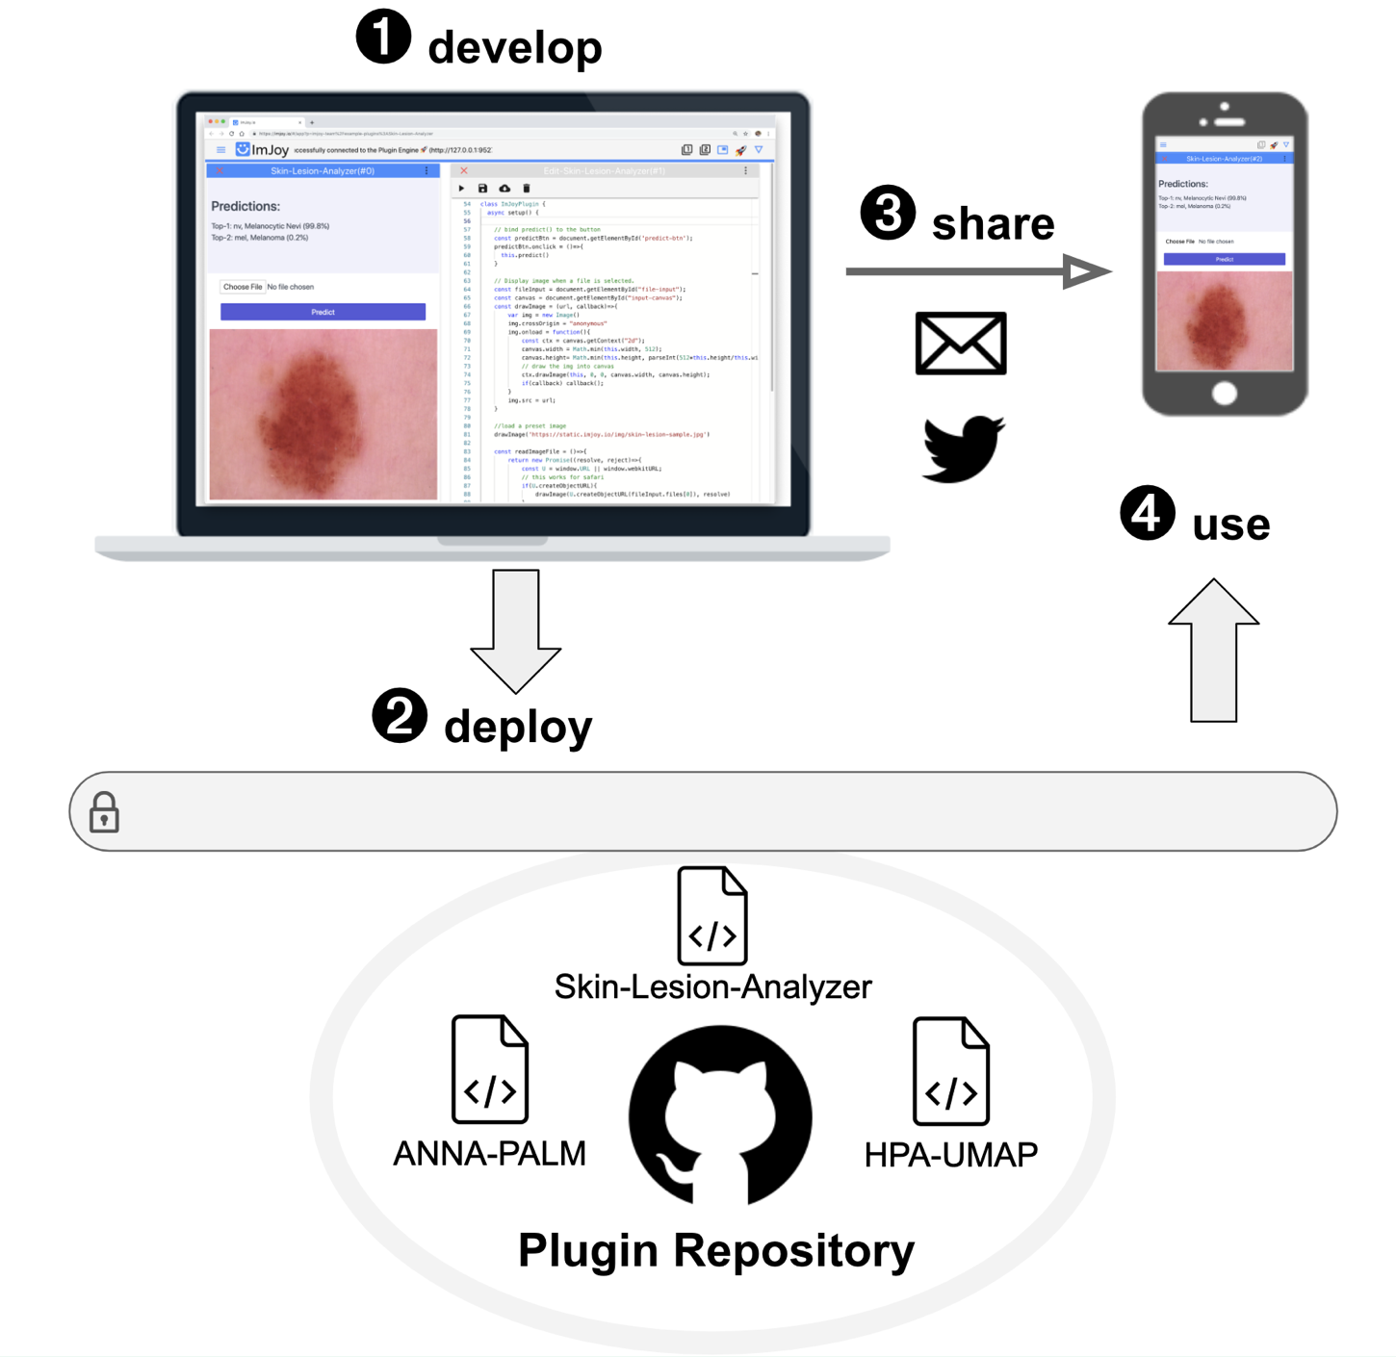
Easy sharing
Privacy aware
https://imjoy.io/#/app?p=imjoy-team/example-plugins:Skin-Lesion-Analyzer
Notes:
https://imjoy.io/#/app?w=imjoy-examples&plugin=imjoy-team/example-plugins:HPA-UMAP&start=HPA-UMAP&fullscreen=1

Slide 15



+
Optical Setup
Exp. Data
LAB
Control Signals
UC2
Multi-Modal Modular Microscope
Open
Lab-in-the-Cloud
Idea-Hub | Think-Tank | Project Junction
User Request
ImJoy, ML/AI
Hardware-Control, Image Analysis
Exp. Data
Control Signals
Control Signals
Processed Data/Results
Sample
Bio exp. setup
Result
Exp. Request
New Ideas
User
User
Notes:
https://imjoy.io/#/app?w=imjoy-examples&plugin=imjoy-team/example-plugins:HPA-UMAP&start=HPA-UMAP&fullscreen=1

Slide 16

TheBox
Shipping
SimpleBox
FullBox
CoreBox
Calibrate/Standardize data acquisition
Easier to generalize machine learning traninig
Apply trained data at differen locations

Slide 17
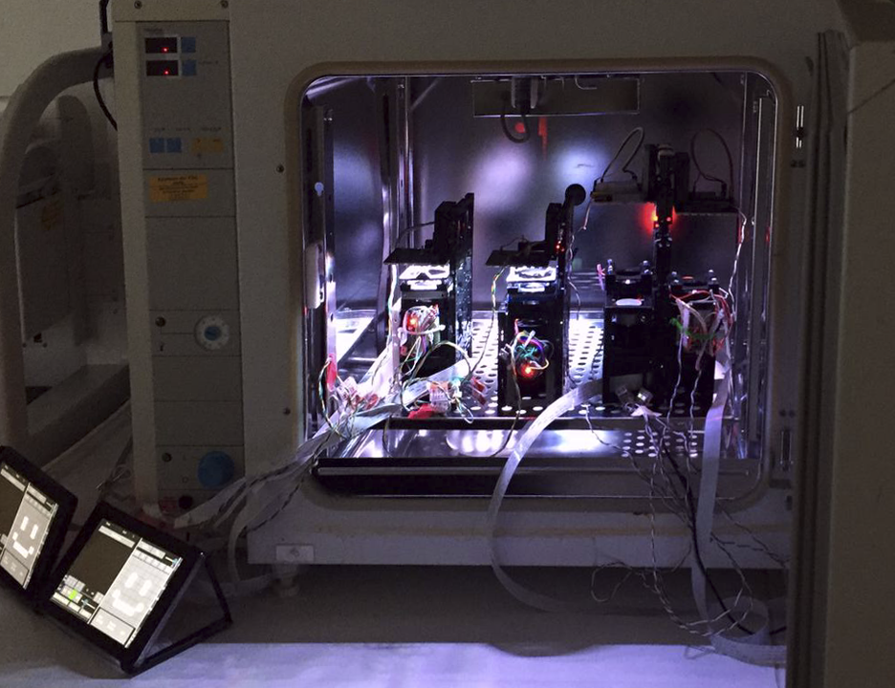


LA
XYZ
MO
CAM
M
1
Idea
2
Look-up Microscope service
3
Choose Setup
Perform experiments
Image Processing

Slide 18
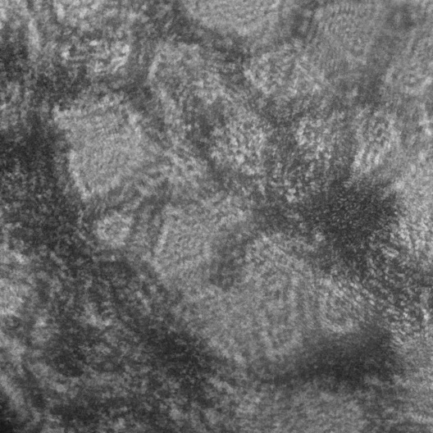
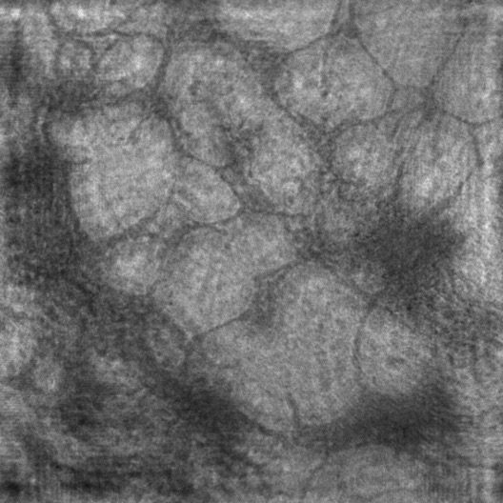
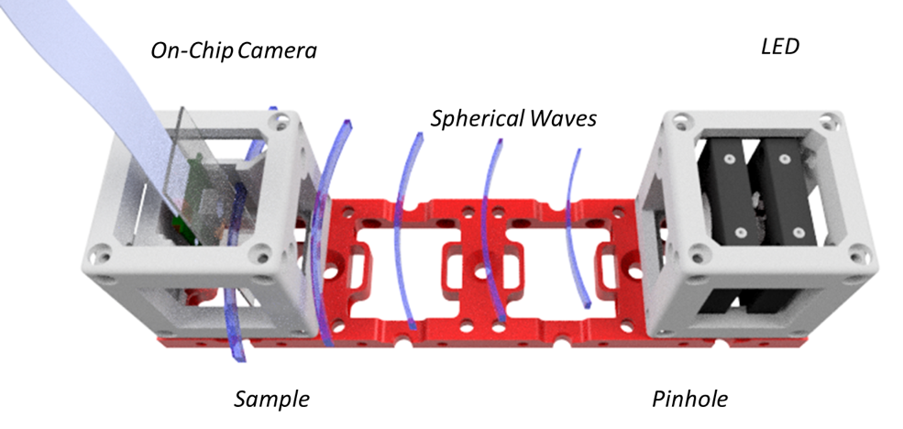
Education Workshops
Inline Holographical Microscopy (lensless)
Cirrhosis, L_ex = 440 nm
PH
Sample
Raw
Numerically Reconstructed
LED
CAM

Slide 19
What we achieved?

Slide 20
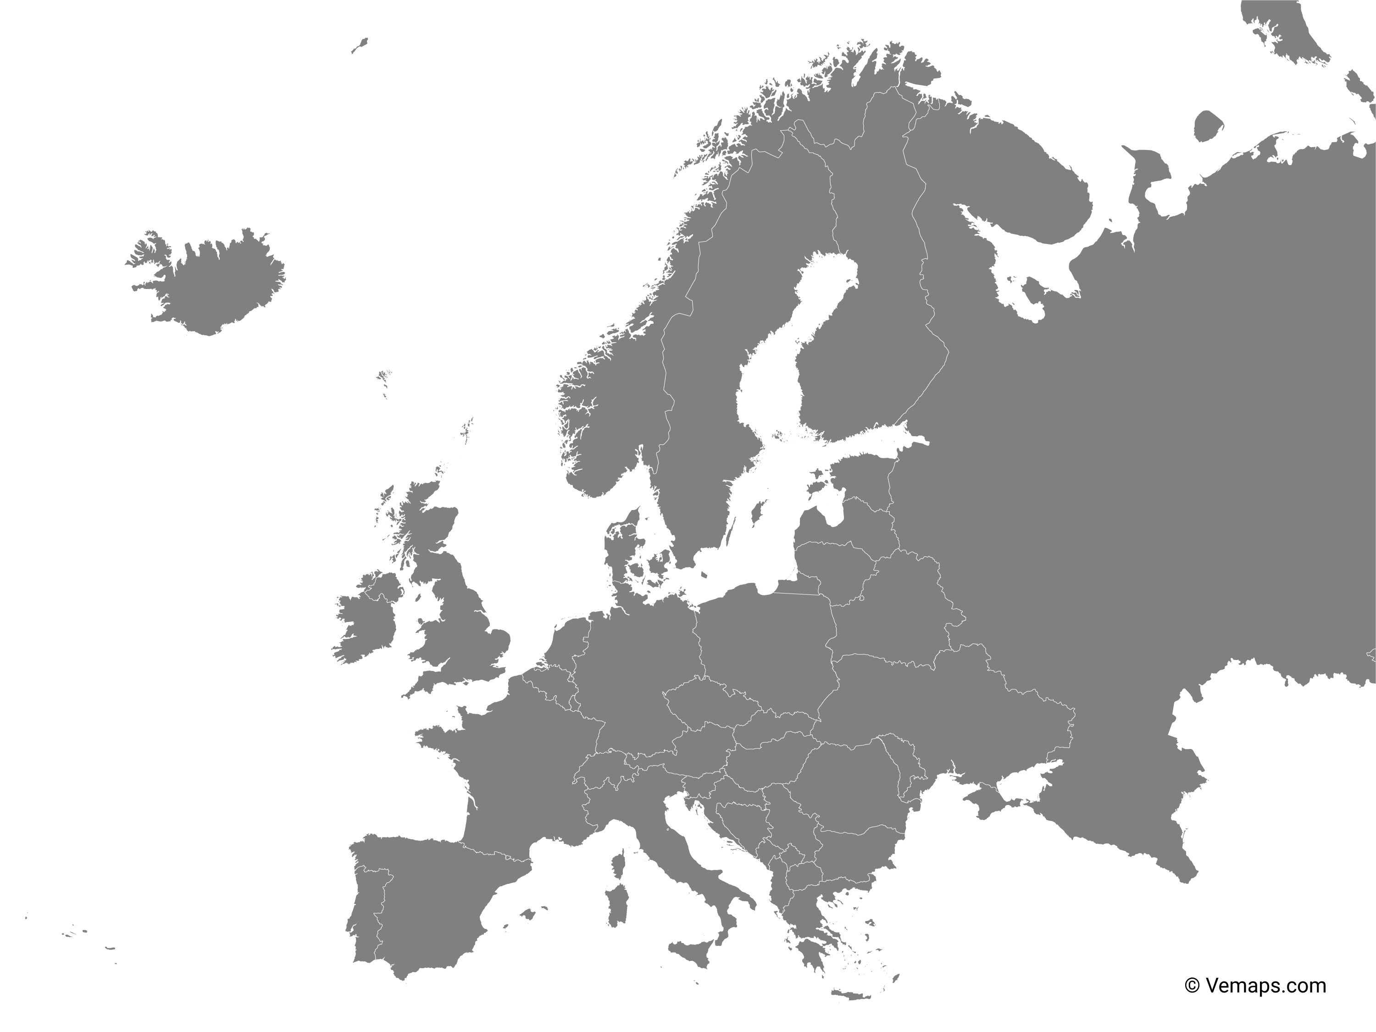
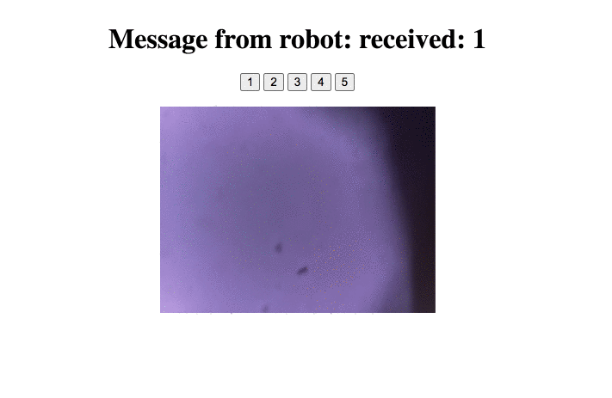
First Microscope in the cloud
Stream Microscope Image accross Europe (Jena->Stockholm)
Control Hardware through WebRTC

Slide 21
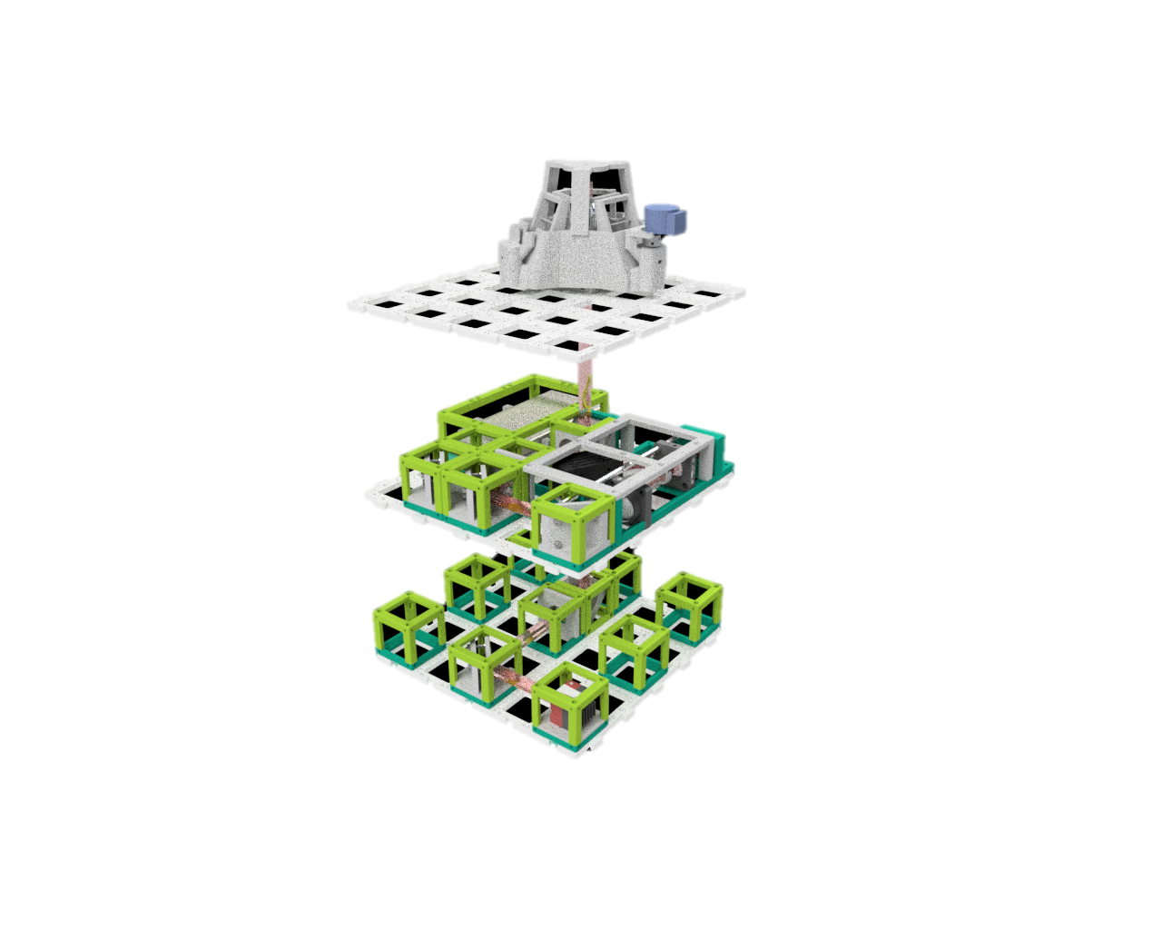

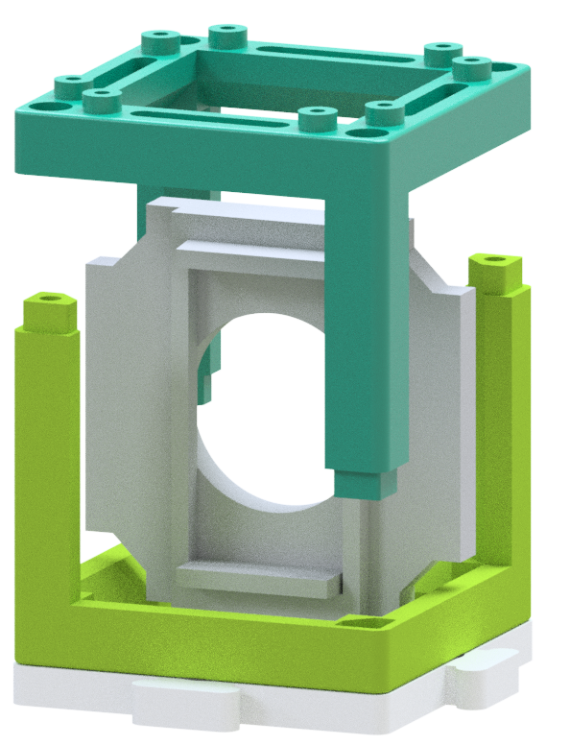

Scaling UC2 by Injection Moulding
d)
a)
Sample Layer
Compatible to 3D printed parts
Point symmetric design
Lego-like mounting
Reproducible
Much more stable
Illumination Layer
b)
c)
Imaging Layer

Slide 22
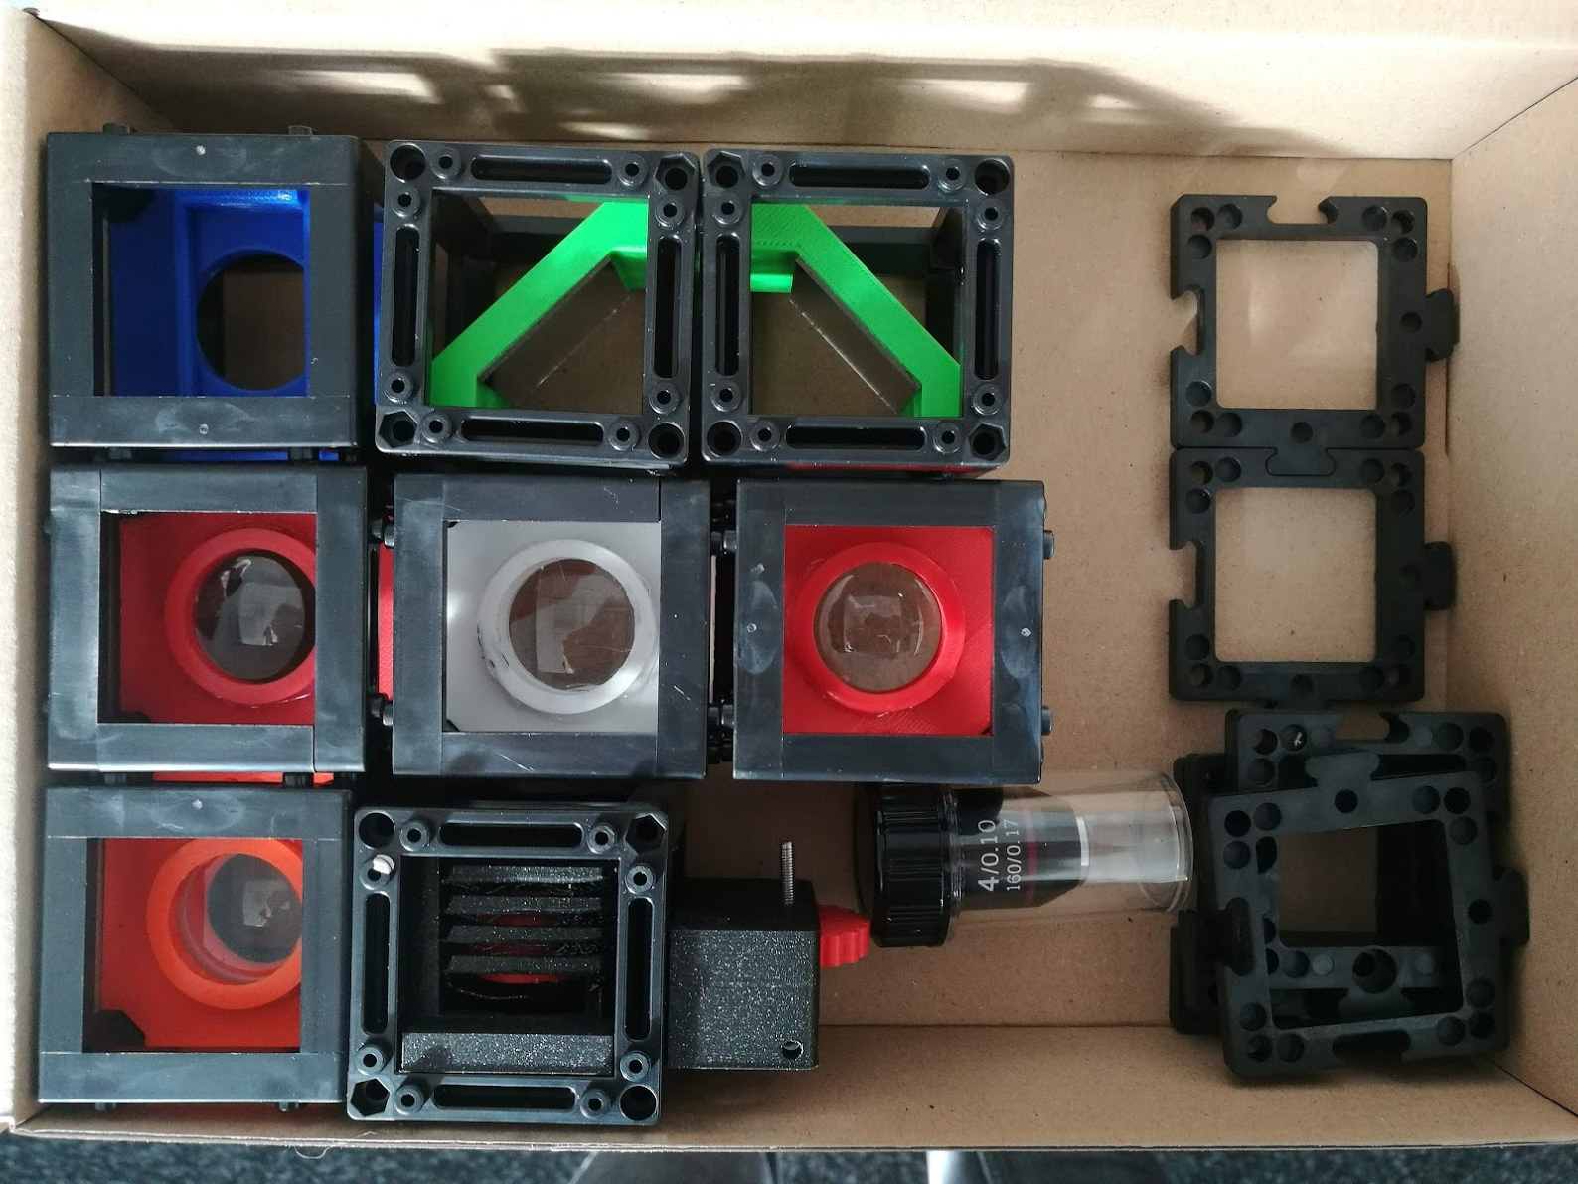
„Ready-to-ship“ - Minibox
Content
Booklet
1x Sample, 1x Grating
2x Mirror
Sampleholder
2x 50mm Lens
1x 100mm Lens
1x -50mm Lens
1x 4x Objective + Z-Stage
-------------------------------
ca. 200 € (material only!)
Setups
Telescope (Galileo, Kepler)
Microscope (Finite/Infnity)
Eyepiece
Periscope
Spectrometer
Projector
Magnifying Glass

Slide 23
What‘s next?

Slide 24




Formulating clear goal
Research?
Educational?
Coding
Making it more robust for external users
Funding opportunities:
Google FRC (Andrew York)
Manu Prakash (Stanford Programm)
ERC „Aim BIG“?
„Large Scale Production“
Research institute is not meant for mass production => (non-profit!) Startup?

